Slide 1


Titolo presentazione sottotitolo
MyTaxiService
Milano, XX mese 20XX
Integration Test Plan presentation

Slide 2
ITPD
This document needs to explain to the development team what to test, in which sequence, which tools are needed for testing (if any), which stubs/ drivers/oracles need to be developed.

Slide 3
Entry Criteria
We must be sure that all the methods inside the components, here considered like black boxes, work as expected.
This is a necessary constraint that must be satisfied, because the purpose of the tests discussed in this document is to check the interaction between components.

Slide 4
Structure from the DD

Slide 5
Integration strategy
We have chosen a bottom-up strategy. We think it's the best choice because represents a more gradual approach to the system testing.
It also allows to find an eventual issue at the deepest level of integration, giving the possibility to intervene immediately at the correct level, without having to resort to a tougher analysis

Slide 6
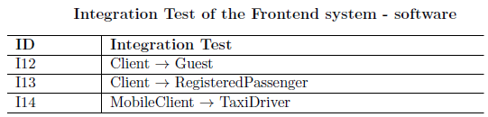
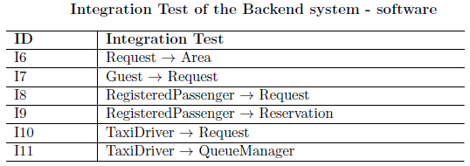
Software Integration Sequence

Slide 7
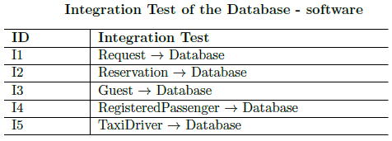
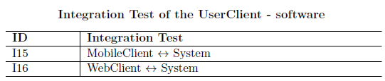
Software Integration Sequence - continue

Slide 8
Subsystem Integration Sequence
In order
Database
Backend system
Frontend system
User clients

Slide 9
Drivers
We used a bottom-up approach with our testing strategy, therefore we utilized drivers instead of stubs:
Request Driver
Guest Driver
RegisteredPassenger Driver
TaxiDriver Driver

Slide 10
Tools and Test Equipment
Arquillan
Arquillian, a testing framework developed at JBoss.org, empowers the developer to write integration tests for business objects that are executed inside a container or that interact with the container as a client.
Manual Testing
The manual testing of the interactions is always available. It may be not a wise choice, because there are no aids nor automations, but it could be the only way to test some parts of your code.

